Slide 1

Department of Computer Science and Engineering
CSA0607 Design and Analysis of Algorithms
CAPSTONE PROJECT PRESENTATION
SkillMatch 360 – Internship Allocation and Student Preference Optimization Engine
Submitted By
Team No.: [6 ]
V. Gayathri(192110276)
G. Rithika(192571027)
S. Jaya Shree (192471041)

Slide 2
1. Project Abstract
SkillMatch 360 is an intelligent internship allocation system that matches students with suitable internship opportunities based on skills, preferences, eligibility, and company requirements.
It uses algorithmic techniques to rank preferences, optimize assignments, and satisfy allocation constraints.
The system explores Brute-Force Assignment Enumeration, Merge Sort Preference Ranking, Subset DP Assignment, Greedy Placement, Backtracking Constraint Satisfaction, and Approximate Matching to improve allocation efficiency.
It aims to provide fair, transparent, and efficient internship assignments while maximizing student satisfaction and matching quality
CSA06 | DAA Group Capstone Project
3

Slide 3
2. Problem Identification
Manual Allocation: Traditional internship allocation is time-consuming and difficult to manage when many students and companies are involved.
Preference Mismatch: Students may receive internships that do not align with their skills, interests, or career goals.
Limited Availability: The number of internship positions is limited, creating conflicts between student preferences and company requirements.
Inefficient Optimization: Existing manual methods struggle to ensure fair allocation, satisfy multiple constraints, and maximize overall student satisfaction.
CSA06 | DAA Group Capstone Project
4

Slide 4
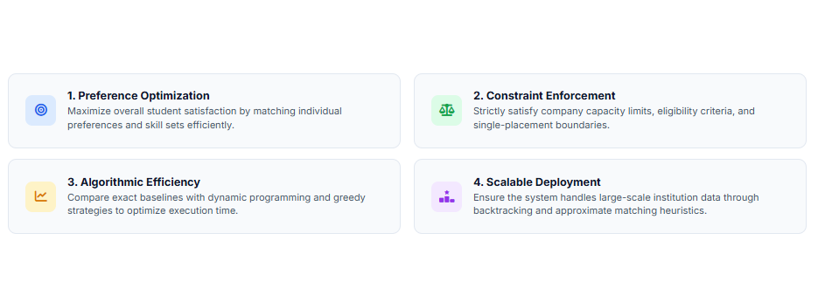
3. Objectives
CSA06 | DAA Group Capstone Project
4

Slide 5
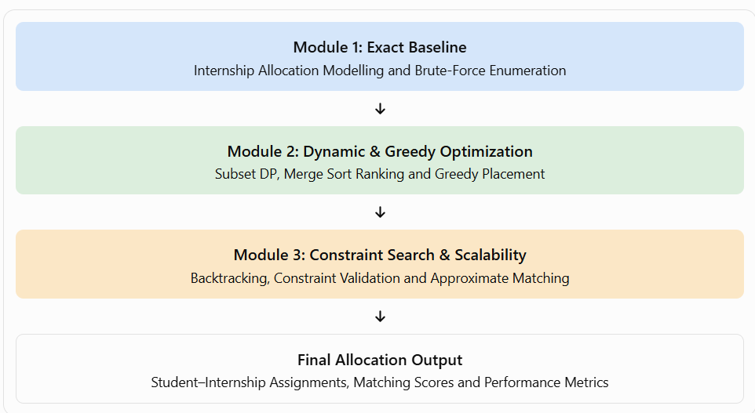
6. Algorithmic Architecture
Brute Force (for trying all possible choices), Merge Sort (for sorting student preferences), Subset DP (for saving previous subgroup answers), Backtracking CSP (for pruning invalid choices early), Greedy Placement (for matching large groups instantly), and Approximate Matching (for fine-tuning final student swaps).

Slide 6
Module 1 — Internship Allocation Modelling and Exact Baseline
Objective: Establish a baseline allocation and determine the optimal solution for small datasets.
Input: Student skills, preferences, eligibility, internship requirements, and slot capacities.
Brute-Force Enumeration: Evaluates all feasible assignments to identify the highest-scoring allocation.
Merge Sort: Ranks internship preferences based on compatibility scores.
Constraint Modelling: Ensures each student receives at most one internship and company capacities are respected.
Output: Baseline allocation, matching scores, and execution time for comparison.
Key Focus: Exact solution and baseline performance.

Slide 7
Module 2 — Internship Allocation Using Dynamic and Greedy Optimization
Objective: Improve allocation efficiency using dynamic programming and greedy strategies.
Subset Dynamic Programming: Reuses previously computed assignment states to find an optimal solution for suitable problem sizes.
Greedy Placement: Assigns students to the best available eligible internships at each step.
Preference Ranking: Uses Merge Sort to prioritize high-scoring internship choices.
Performance Evaluation: Compares allocation quality and execution time against Module Output: Optimized assignments with reduced computation for suitable datasets.
Key Focus: Balancing allocation quality and computational efficiency.

Slide 8
Module 3 — Internship Allocation Using Constraint Search and Scalability
Objective: Handle complex constraints and larger allocation datasets efficiently.
Backtracking: Explores alternative assignments and reverses decisions when constraints cannot be satisfied.
Constraint Satisfaction: Validates eligibility, student assignment limits, and internship capacities.
Approximate Matching: Produces high-quality allocations for larger datasets within practical computation limits.
Scalability Testing: Evaluates runtime, matching scores, and the number of valid assignments as dataset size increases.
Output: Constraint-valid allocations with scalability and performance reports.
Key Focus: Constraint handling, scalability, and efficient allocation.

Slide 9
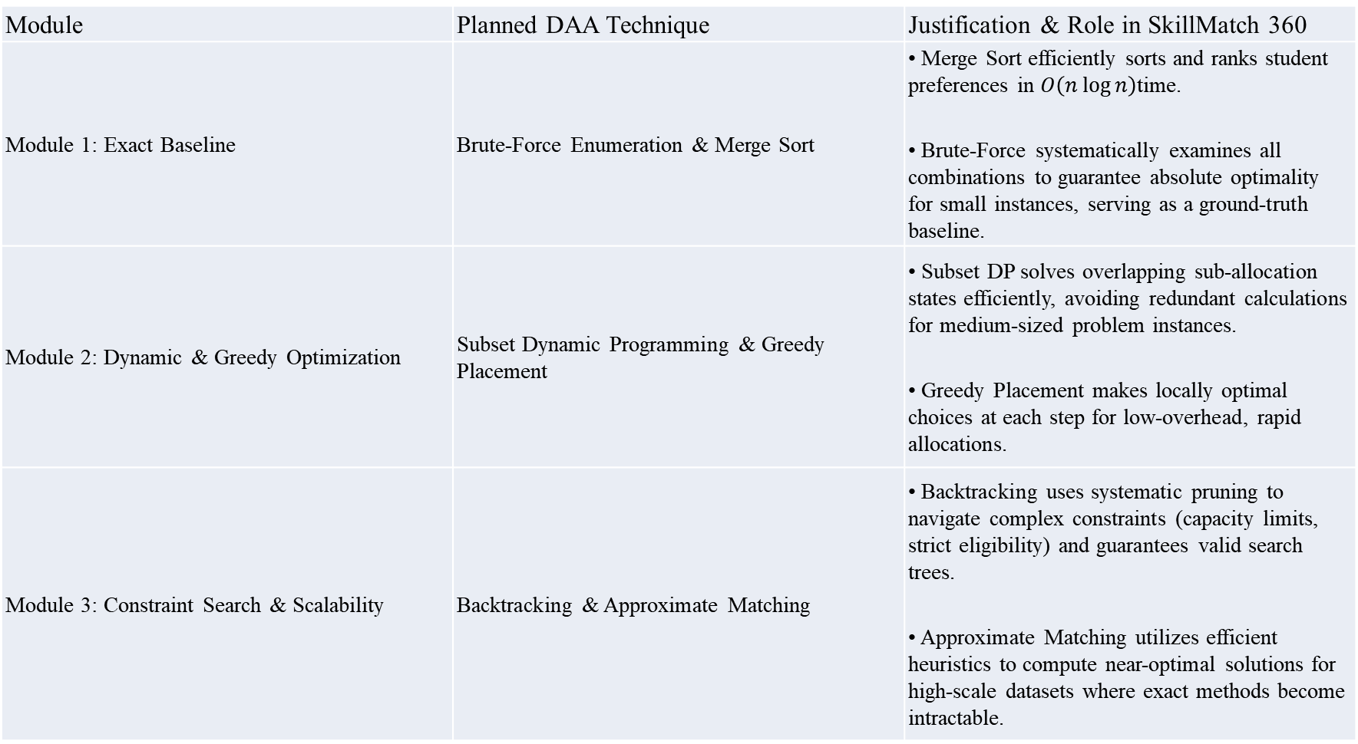
Proposed Algorithmic Approach
Module | Planned DAA Technique | Justification & Role in SkillMatch 360
Module 1: Exact Baseline | Brute-Force Enumeration & Merge Sort | • Merge Sort efficiently sorts and ranks student preferences in $O\left(n\log{n}\right)$time. • Brute-Force systematically examines all combinations to guarantee absolute optimality for small instances, serving as a ground-truth baseline.
Module 2: Dynamic & Greedy Optimization | Subset Dynamic Programming & Greedy Placement | • Subset DP solves overlapping sub-allocation states efficiently, avoiding redundant calculations for medium-sized problem instances. • Greedy Placement makes locally optimal choices at each step for low-overhead, rapid allocations.
Module 3: Constraint Search & Scalability | Backtracking & Approximate Matching | • Backtracking uses systematic pruning to navigate complex constraints (capacity limits, strict eligibility) and guarantees valid search trees. • Approximate Matching utilizes efficient heuristics to compute near-optimal solutions for high-scale datasets where exact methods become intractable.

